Slide 1

TFL Cycling Data Analytics
Anum Hassan

Slide 2
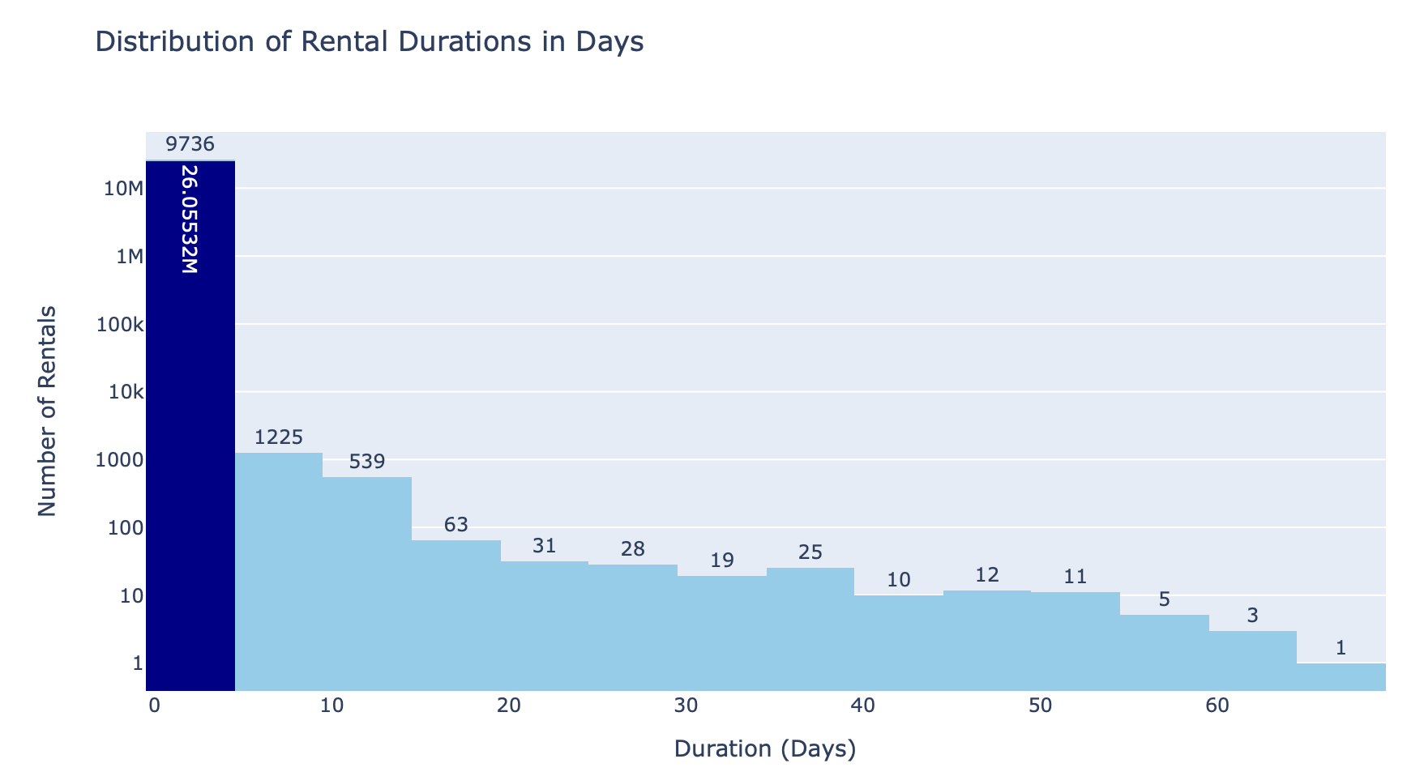
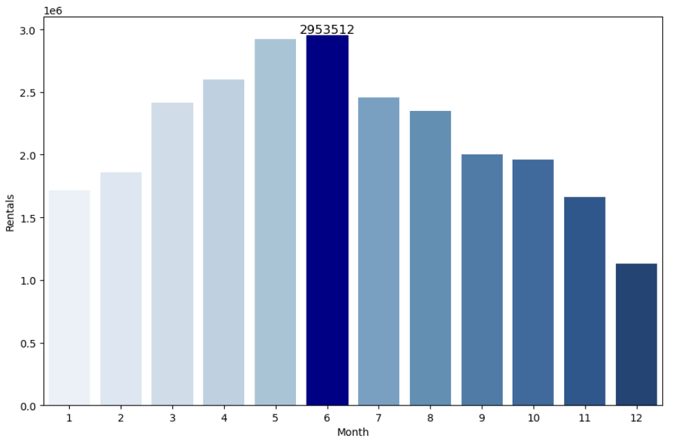
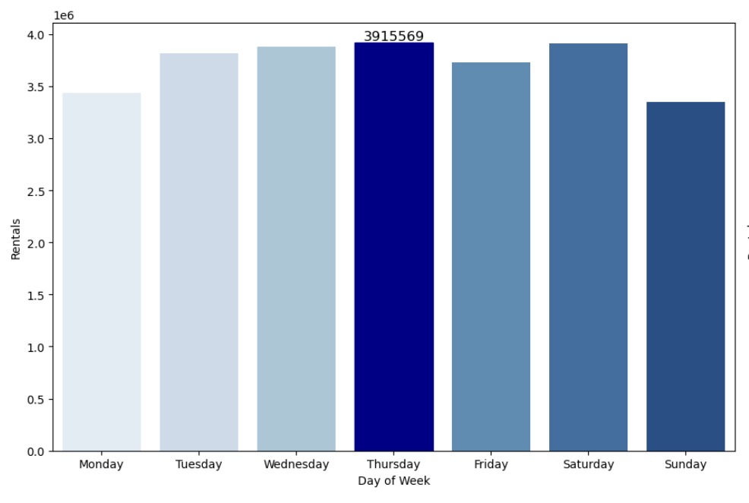
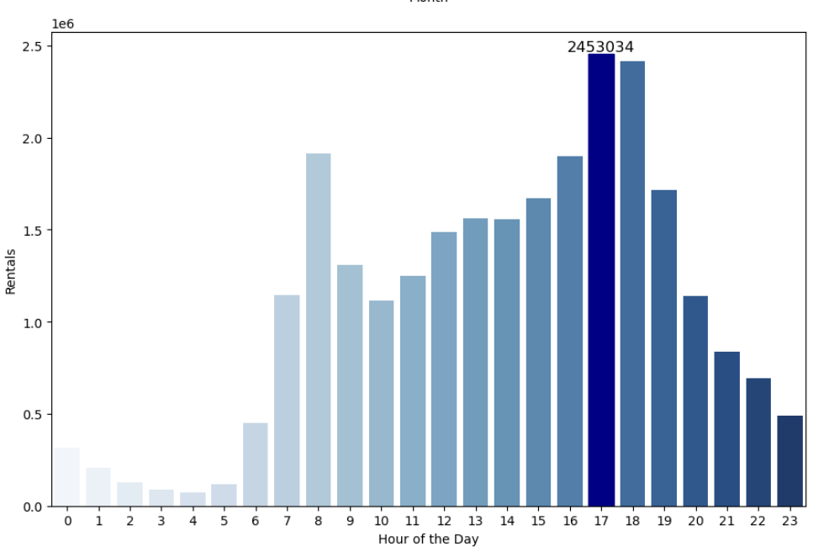
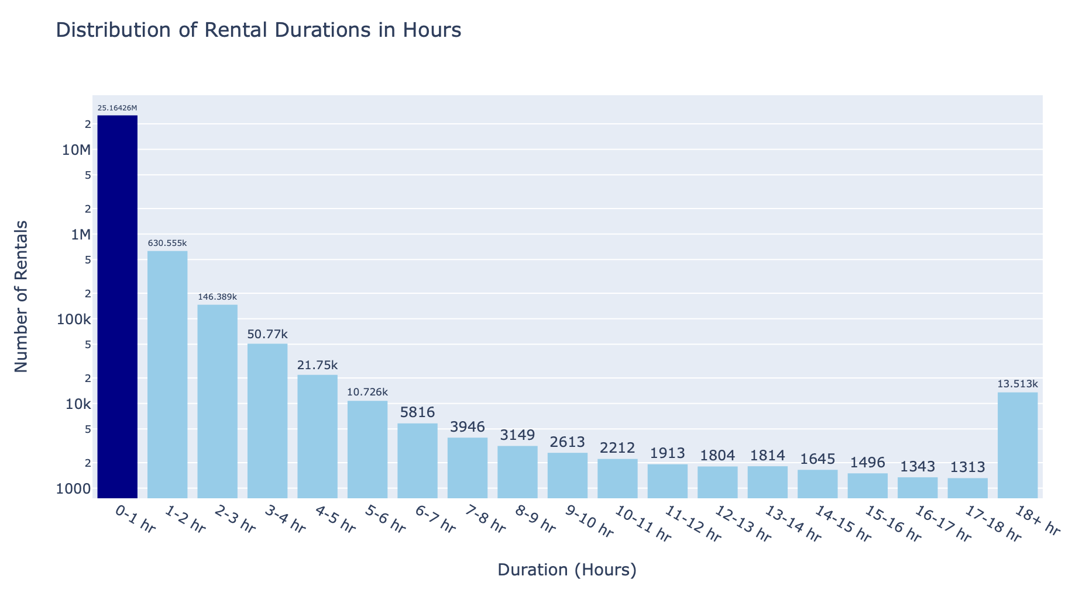
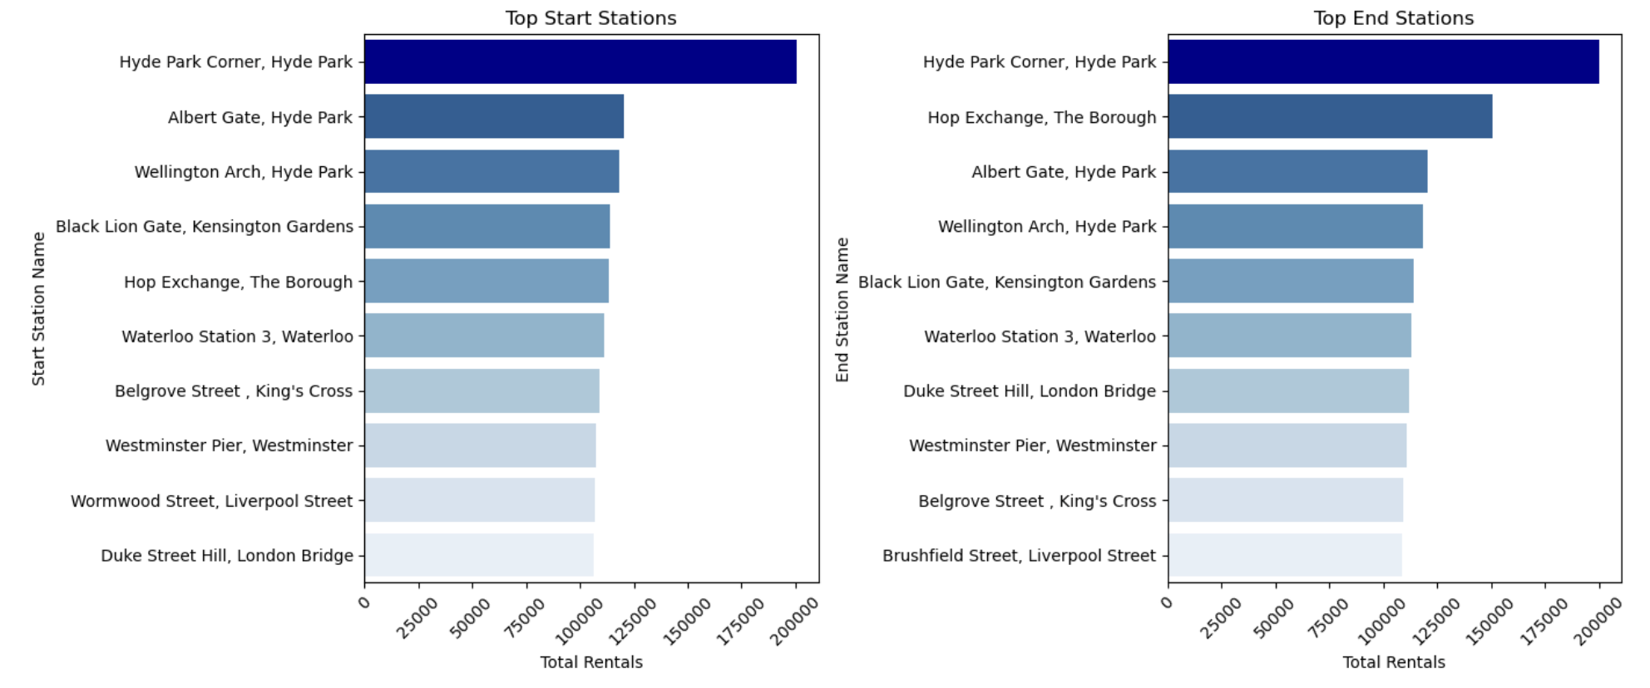
Exploring London’s Cyclic Patterns
Rental Duration Analysis
Temporal Analysis
Rentals by Month
Rentals by Weekday
Rentals by hours of the day
Rental duration by days
Significant majority of customers prefer short-term rentals, typically with same day return
June has the highest rentals,
suggesting weather related trend
Thursdays are the most popular days for rentals, indicating a consistent pattern of usage during the weekdays.
17th hour of the day emerged as the peak rental hour, indicating a preference for late afternoon or early evening cycling among users.
Rental duration by hours
Significant majority of customers prefer short trip, typically with same hour
Station Analysis
Top Start Stations
Top End Stations
Hyde Park Corner emerges as the most popular start and end station, with a significantly higher usage frequency

Slide 3





Data Science Use Cases
TFL Cycling Data use cases
Demand Forecasting
Route optimization
Pricing Strategy
Operational Efficiency
Seasonal trending
Notes:
Demand Forecasting: Predict future bike rental demand based on historical rental patterns, weather conditions, special events, and other relevant factors. This can help optimize bike availability and allocation.
Route Optimization: Optimize bike station locations and the allocation of bikes to stations to minimize empty or full stations. Machine learning models can help identify the best locations and rebalancing strategies.
Pricing Strategy: Analyze the relationship between rental prices, demand, and other factors to determine optimal pricing strategies that maximize revenue and ridership.
Operational Efficiency: Use data to optimize maintenance schedules, repair, and inspection of bikes and stations to reduce downtime and increase bike availability.
Seasonal and Temporal Trends: Identify seasonal and temporal patterns in bike rentals. For example, which months, days, or times of day are the busiest, and how does this change over time?

Slide 4
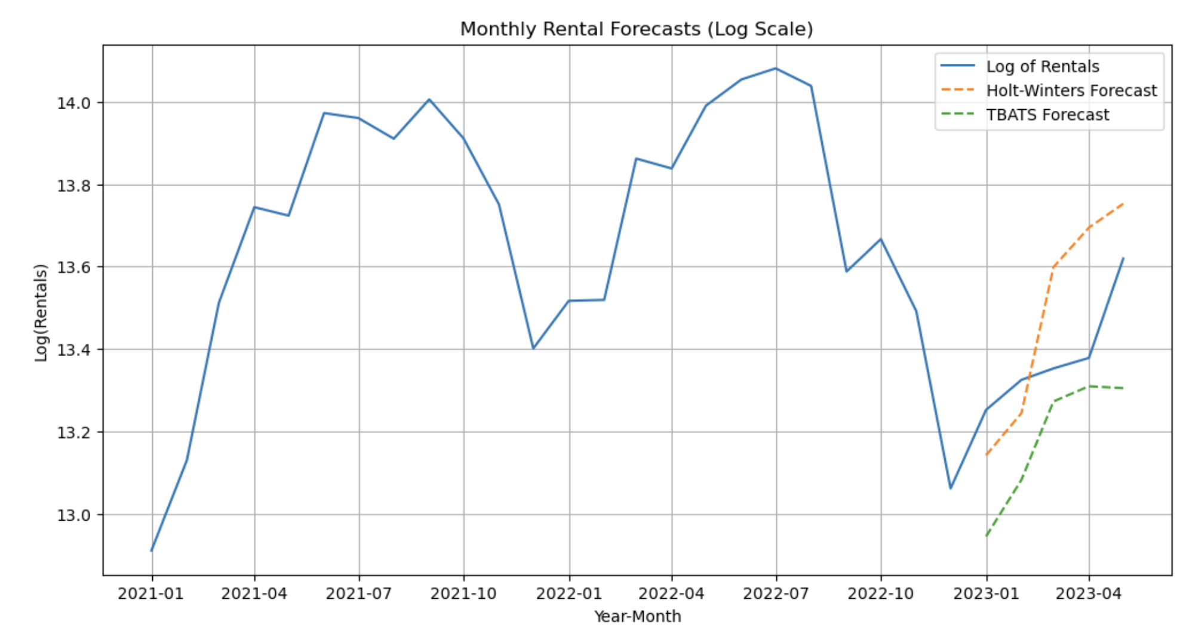
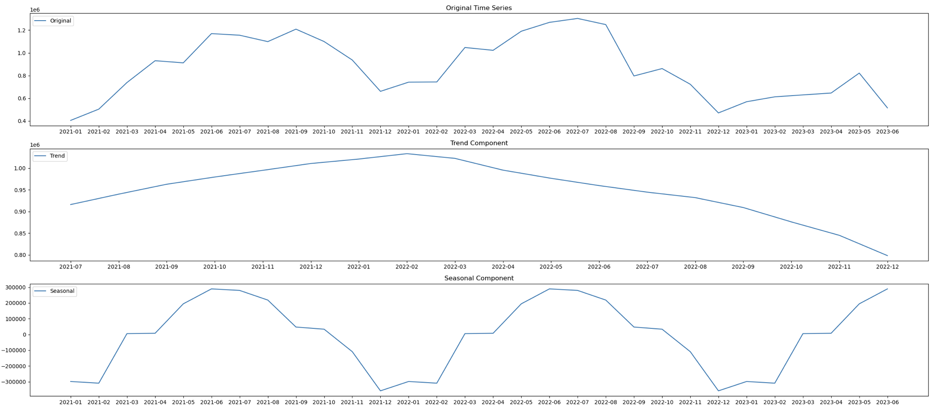
Prototype Model: Demand Forecasting
Predict the demand for rental cycles for the upcoming 6 months based on historical monthly rental data.
Data has no obvious trend
It has multiplicative seasonality
Bike rental demand forecast for the next 6 months to optimize bike availability and location and
meet customer demand effectively.

Slide 5
Key Recommendations
1. Supply Chain Optimization
Hyde Park Corner Expansion: Since Hyde Park Corner is the most popular start and end station, invest in expanding and optimizing services in this area.
2. Seasonal Marketing
Optimize Service for Hourly Rentals: Given that the most common usage pattern is for short trips within the same hour, consider offering hourly rental options.
Weekday Specials: As Thursdays are the most popular days for rentals, consider introducing weekday specials or discounts to incentivize usage during weekdays.
Peak Rental Hour Services: To meet the high demand during the 17th hour of the day, ensure that you have an adequate supply of bikes available during this time.

